Slide 1

Correlation Coefficient
$$r=\frac{\sum{z_{X}z_{Y}}}{n−1}$$

Slide 2

Covariance
$$c=rs_{X}s_{Y}$$

Slide 3

Effect Size
Coefficient of determination: $r^{2}$ or $R^{2}$

Slide 4
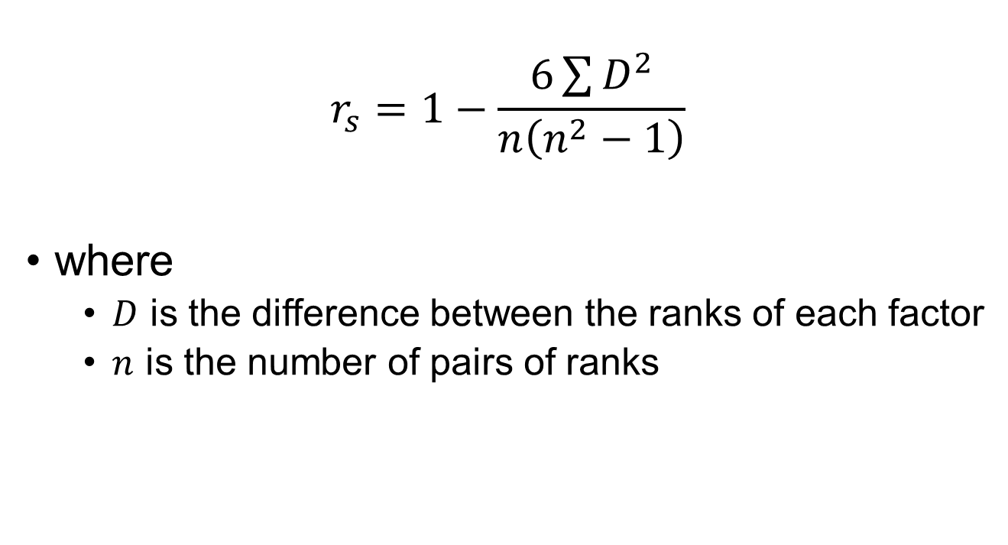
Spearman Correlation
$$r_{s}=1−\frac{6\sum{D^{2}}}{n\left(n^{2}−1\right)}$$
where
$D$ is the difference between the ranks of each factor
$n$ is the number of pairs of ranks

Slide 5
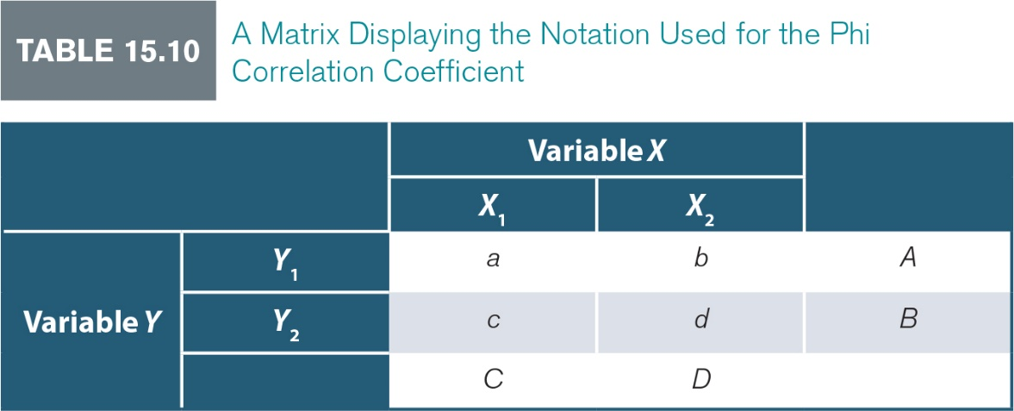
Phi Correlation
$$r_{φ}=\frac{ad−bc}{\sqrt{ABCD}}$$

